Slide 1
SHRI SHANKARACHARYA TECHNICAL CAMPUS
Shri Shankaracharya Group of Institutions
Department of Computer Science & Engineering
B.TECH - 7th Semester (Session 2020-21)
Project Title : Face Recognition System
Name of Project Members:
1. Aakanksha Rani ( En-BE3433 , Roll No. - 01 A)
2. Bhawana Tiwari ( En - BE3694, Roll No. - 39 A)
3. Gunjan Tiwari ( En- BE3639, Roll No. - 53 A )
4. Utkarsh Singh (En -BE3687, Roll No. - 58 A)
Name of the Proposed Guide: Aditi Mishra Mam

Slide 2
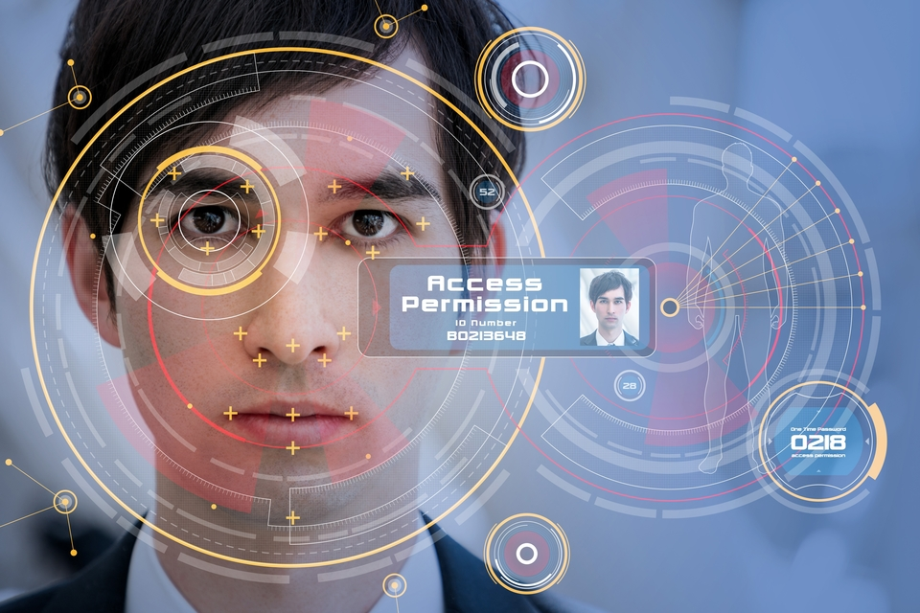
Index
1.Introduction
2.Problem Statement
3. Methodology
4.How it works?
5.Sequence Diagram
6.Hardware & Software Requirements
7.Application
8.Future Scope
7.References

Slide 3
Introduction
Face Detection and Recognition System- It is a biometric method of identifying an individual by comparing live capture or digital image data for stored record of that person.
Face Detection based attendance system - This is an application based on face detection system and has the features to replace the fingerprint biometrics system.
Face recognition analyzes facial characteristics. It requires a digital camera to develop a facial image of the user for authentication. Facial features are the most important thing in face recognition. It extracts features from a face image and compares them with those stored in the database for identification.

Slide 4
Problem Statement
The Human face is a very challenging pattern to detect and recognize because of its rigid anatomy.Although systems have been developed for face detection and tracking, reliable face and recognition still offers a great challenge to computer vision and pattern recognition researchers. Images of the same individual taken at different times, may sometimes exhibit more variability due to the aforementioned factors (intrapersonal variability), than images of different individuals due to gender, race, age and individual variations (extra personal variability). One way of coping with intrapersonal variations is including in the training set images with such variations. And while this is a good practice for variations such as facial expressions, use of cosmetics and presence of glasses or beard, it may not be successful in case of illumination or pose variations.

Slide 5
Methodology:
It is based on basic python based algorithm, which enable non-contact based attendance system.
Using smart Machine Learning concept to recognise face.
To do this, we activate a python scripting file.
IDL 3.7 is used as interpreter and to activate PyCharm.

Slide 6
The whole algorithm is divided into 3 parts:-
Face detection(DATA SET ENTRY)
Face training.
Face recognition.
ML python code
FACE DETECTION
FACE TRAINING
FACE RECOGNITION

Slide 7
Start
Webcam initialization
// Computer vision tool is used to activate webcam.Run the first part of the code-face detection for data set creation.
Run ML Algorithm
// Data creation.
N images clicked and stored in a file.
// Data set saved.
Comparison loop.
// Compare new image to dataset.
Attendance system.
// If match fill attendance.
Stop

Slide 8
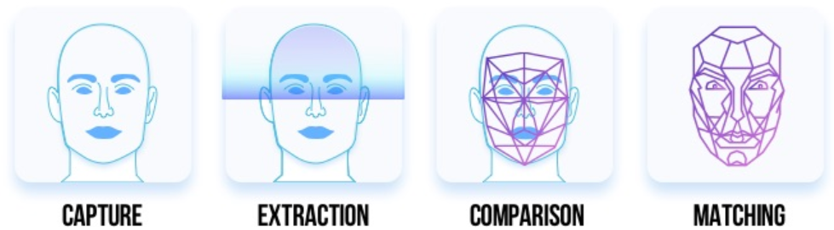
How it Works

Slide 9
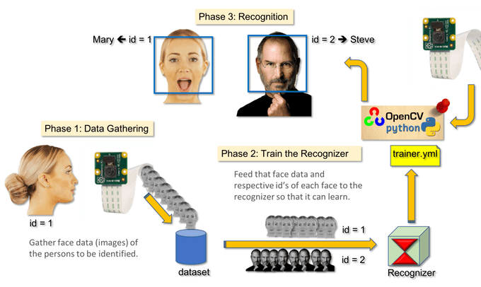

Slide 10
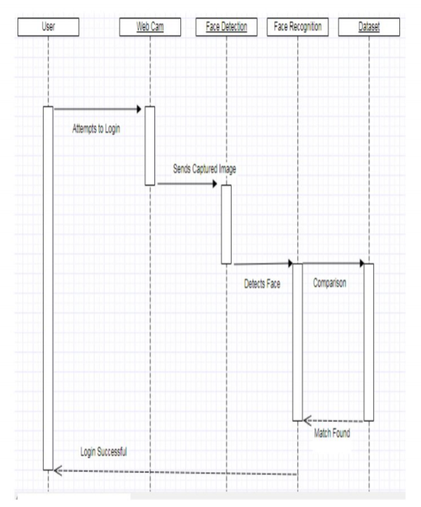
Sequence Diagram

Slide 11


Hardware / Software Requirements
1. Processing:Core 2 Duo with processing speed 2.0 GHz
2 . Memory:2GB RAM
3. 50 GB Hard Disk(minimum)
4. A digital webcam
5. Latest Windows Os
6. Language: python
7. MYSQL Database

Slide 12
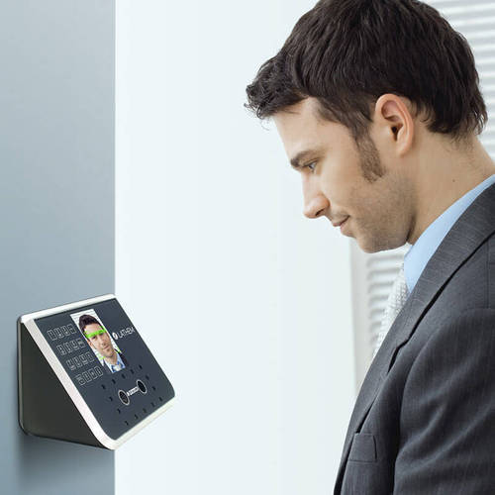
Application
Used to automatically fill the attendance of present students/employees in colleges/offices and many other places too.
A check over submission of false attendance of absentees.
A non-contact way of taking attendance ensuring the safety of students and employees during and after COVID-19.
Reduces the workload of teachers in maintaining the
attendance record of students.

Slide 13
Future Scope
Apply Machine Learning for better face detection or accuracy.
Real Time attendance system.
Using maximum threshold value so blur face also detect with accuracy.
Working on making the system as low requirement storage wise and processing wise.

Slide 14
REFERENCES
https://dev.to/graphtylove/how-to-automate-attendance-record-with-face-recognition-python-and-react-4413
https://www.baseapp.com/deepsight/attendance-system-using-face-recognition/
https://www.hackster.io/raied286/attendance-system-facial-recognition-open-cv-ml-f6a959
https://www.tutorialspoint.com/python/python_modules.html

